Slide 1
Web Development 2

Slide 2
Project 1a and 1b

Slide 3
Project Overview
Research a new web technology as part of a group and present what you have learned to the class
Create a website that provides an overview of the technology that you researched
This is a group project
The instructor will assign groups
Groups will be the same for both projects 1a, 1b, and 2
Due December 4 – 6
Depends on the selected presentation date
More details can be found on the instruction sheet for this project

Slide 4
Project Objectives
Group Collaboration: Learn the essentials of effective teamwork, contributing equitably to a shared goal.
Modern Web Tools: Gain hands-on experience with contemporary web tools like Git for version control and Sass for CSS pre-processing.
Exploratory Research: Investigate emerging trends or technologies in web development and summarize findings.
Knowledge Sharing: Share acquired insights with the class via a presentation and website, fostering a collaborative learning environment.
Presentation Skills: Develop the ability to convey technical information clearly and compellingly.
Communication Skills: Build essential communication skills vital for succeeding in the professional world.
Note: The above points generated by ChatGPT from rough objectives provided by Michael Whyte

Slide 5

Groups
Groups will be randomly selected in class
Group size will be 4 – 5 students
Groups will be the same for all projects for the Web Development 2 course

Slide 6
Benefits of Group Work
Diverse Perspectives: Access to a variety of viewpoints that can lead to more comprehensive solutions.
Skill Enhancement: Opportunity to learn from peers, thus improving one's skill set.
Resource Pooling: Sharing of resources, be it time, expertise, or tools, to more efficiently achieve project goals.
Shared Responsibility: Workload distribution among team members can lead to better time management and less stress.
Accountability: Regular group meetings and peer evaluations can foster a sense of responsibility.
Conflict Resolution: Learning to resolve disagreements constructively is a valuable workplace skill.
Social Skills: Interaction within a group helps improve interpersonal skills, including communication and empathy.
Note: The above edited points were originally generated by ChatGPT

Slide 7

Topic Selection
Each group must select a unique topic
Topics are selected on a first-come-first-serve basis
When your group has selected a topic, notify your instructor

Slide 8

Topic Selection
Available Topics
CSS Custom Properties (CSS Variables)
CSS Transitions, Transforms, and Animations
CSS Selectors Beyond Class, ID, and Element Selectors
3 - 5 New or Up-and-Coming CSS Technologies
SVG
Markdown
Bootstrap or Similar Framework
Web APIs such as Geolocation, Fetch, and Web Storage
Static Site Generators
Progressive Web Apps
Other Topics with Instructor Approval

Slide 9
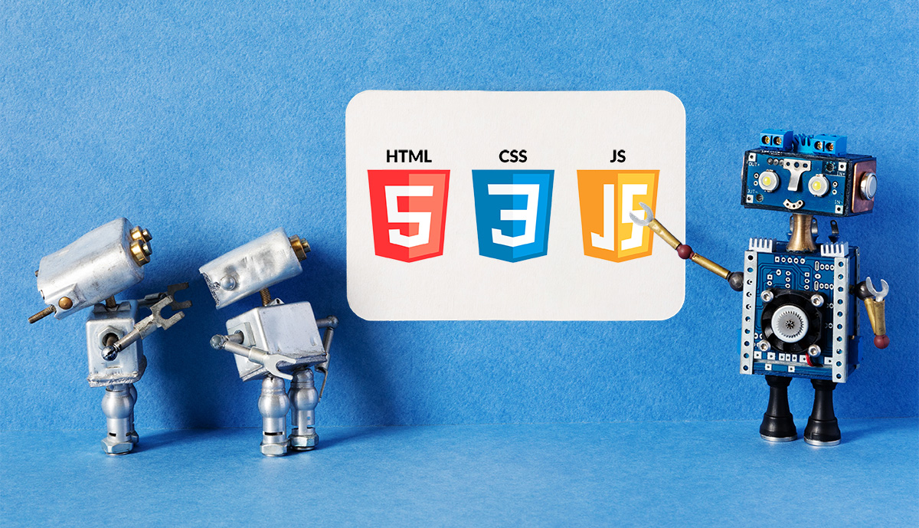
Project 1a - Presentation
Duration 10-20 minutes
Content Requirements
Technology Overview
What is it
What does it do
Why would you use it
Where would you use it
Pros and Cons
A code demo or technology walk-through

Slide 10

Project 1b - Website
Technical Requirements
One or more page website
Hosted and shared using GitHub’s Pages feature
See this link for instructions on how to create a GitHub Pages site:
https://docs.github.com/en/pages/getting-started-with-github-pages/creating-a-github-pages-site
Share the URL to your site with the class in the Slack channel for the Web Scripting 3 course
Content Requirements
Like the presentation, answer the what, why, where, and how of your chosen topic

Slide 11
Project 1a – Presentation Rubric
Excellent level for the evaluation criteria
Topic Understanding: Demonstrate a comprehensive understanding of your selected web technology and articulate its use cases and applications well.
Code Demo and Walk-Through: Provide an exceptionally clear and insightful code demonstration that not only works but significantly contributes to the understanding of the technology.
Presentation Skills: Deliver a presentation that is exceptionally clear, engaging, and well-organized, capturing and maintaining the audience's attention throughout.
Group Collaboration: Exhibit clear evidence of equitable and effective collaboration among all group members, where everyone has contributed significantly to the project.
Relevance and Originality: Go beyond the basic requirements by adding unique perspectives or elements that are not only relevant but offer original insights into the topic.
Time Management: Adhere perfectly to the 10–20-minute guideline, utilizing the time effectively to cover all important points without rushing or stretching the content.

Slide 12
Project 1b – Website Rubric
Excellent level for the evaluation criteria
Content Quality: Present a comprehensive and insightful overview of the selected technology that fulfills all specified content requirements, leaving no gaps in information.
Design and Usability: Create an exceptionally user-friendly and visually appealing design that complements and enhances the content, ensuring a seamless user experience.
Code Quality: Develop clean, efficient code that adheres to industry best practices, demonstrating mastery over the technologies used.
GitHub Pages: Maintain a well-organized public repository and properly set up the GitHub Pages site. The URL should be shared as instructed, and the repository should facilitate easy navigation.

Slide 13
Project Submission
Live In-Class Presentation
One group member should submit a URL to the group’s GitHub Pages URL

Slide 14
Project Penalties
Presentation component
10% for not being in attendance for other group presentations
Website component
5% per to a maximum of 50%
No projects accepted that are more than 14 days late

Slide 15
Strategies for Effective Group Work
Clear Role Assignment: Define roles and responsibilities for each group member to ensure a balanced workload.
Communication Channels: Establish a regular communication channel such as Slack, Microsoft Teams, or regular meetings to keep everyone in the loop.
Timelines and Milestones: Develop a project timeline with milestones and deadlines to keep the team on track.
Conflict Resolution: Agree on a method for resolving conflicts or making decisions, whether by majority vote or consensus.
Note: The above edited points were originally generated by ChatGPT

Slide 16
Strategies for Effective Group Work
Version Control: Utilize version control tools like Git to manage changes and avoid work duplication.
Regular Check-ins: Schedule meetings to assess progress, discuss challenges, and recalibrate roles or tasks as needed.
Peer Reviews: Incorporate a peer review process to evaluate each other’s contributions and ensure high-quality output.
Feedback Loops: Create mechanisms for internal feedback before the final submission to improve the quality of the work.
Note: The above edited points were originally generated by ChatGPT

Slide 17
FAQs
What technology should my presentation be in?
You can use whatever you like…
PPT, Google Slides, Canva, or other web-based presentation tools could be used.
Create a web page and present that.
Create demo pages and show your code…
The goal of the presentation is to communicate what, why, where, and how of the technology to the class.
Can we show a pre-existing YouTube video not made by our group on the screen and call it a day?
No, however, if the video you are showing is less than 30% of the total duration of your presentation, then that is fine.
You are allowed to include links to videos or embed videos made by others on your GitHub Pages website.

Slide 18
FAQs
Can we use Bootstrap for our GitHub pages site?
Yes
Can we use other web technologies like Sass and jQuery?
Yes, if it is compatible with GitHub Pages
Can we upload our presentation to our GitHub pages site?
Yes, if you think it adds to your webpage.
Just make sure to link to it in your document. Don’t just upload it to your GitHub repo.
Do we have to attend the other group presentations?
Yes, if you do not attend the other groups’ presentations without a valid reason, you will receive a 10% penalty.

